Slide 1
15a irish red ale

Slide 2
Agenda
History
Style
Recipe
Process

Slide 3
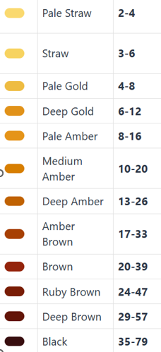
definitions
SRM – Standard Reference Method. A number 1-80, although the human eye can only discern up to about 40. Usually used to talk about beer (the final product of all the recipe elements.
Lovibond – A measure of the color of individual malts, or the wort made from those malts.
Light 1-10L (Pilsner is about 2L)
Medium 10L – 45L (dark Munich is about 10L)
Dark 45L and up (C-120, RoastBar 500, etc…)
Esters – A group of aromas known for generally being fruity (pear, red apple), usually a product of yeast activity.

Slide 4
history

Slide 5
cicerone

Slide 7
Mash temp ~152 – 155*
3.8 – 5% ABV
Medium-light to medium body.
Moderately attenuated.
 | Specific Gravity | Plato
Original Gravity | 1.036 – 1.046 | 9 – 11.4
Final Gravity | 1.010 – 1.014 | 2.5 – 3.6

Slide 8
Craft beer & brewing magazine
The key to this recipe is balance: base malt, caramel, roast, bitterness, alcohol.
Skip the dark roasted barley and try chocolate rye
Pick a specifically Irish yeast
Wyeast 1084
White Labs WLP 004
Danstar Nottingham
Ferment cool
63 for 4-5 days
68 until finished
Mash at 152*
https://beerandbrewing.com/make-your-best-irish-red/
“Make your best _______”
10 lb base malt (Maris Otter)
6oz Light Crystal (Fawcett 45 or C-40)
4oz Dark Crystal (C-75)
2oz Extra Dark Crystal (120 or 160)

Slide 9
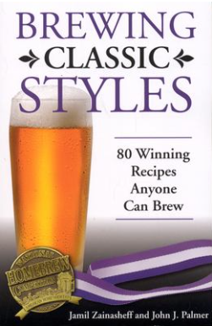
Brewing classic styles
The key to this recipe is balanced malt and hop bitterness. The dark roasted malts will contribute to the dry finish.
Must keep dark malt, caramel malt, and hops in balance. Use restraint.
Can be brewed as a lager or an ale. Should have a clean fermentation profile with minimal esters. Ferment cool to suppress esters, but give it enough time to fully attenuate.
Mash at 153*
8.1 lbs English Pale Ale extract (or replace with 11.25 lbs English Pale malt)
Steeping Grains: 6oz C-40, 6oz C-120, 6oz Roasted Barley
Kent Goldings @ 60 minutes for 25 IBUs
White Labs 004, Wyeast 1084, Fermentis US-05

Slide 10
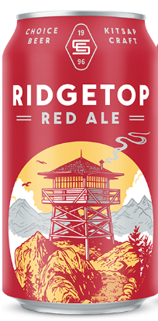
Ridgetop red
Mashed slightly warm
Bitter to 14 IBU
Some whirlpool hops for aroma
Fermented 66 – 72*
60% 2-row
26% Munich
4% C-40
4% Carawheat
5% Dark Wheat
1% Carafa II

Slide 11
Homebrew recipe
13 lb 2-Row
.75 lb C-40
6oz C-120
6oz Roastbar 350
2 oz East Kent Golding @60m
2 oz East Kent Golding @30m
21 calculated IBUs
Mash at 152*
Acidify with phosphoric acid
Wyeast 1084 Irish Ale Yeast
Scored 38 at 2023 Oregon Brew Crew Fall Classic
Scored 40.5 at 2023 Novembeerfest

Slide 12
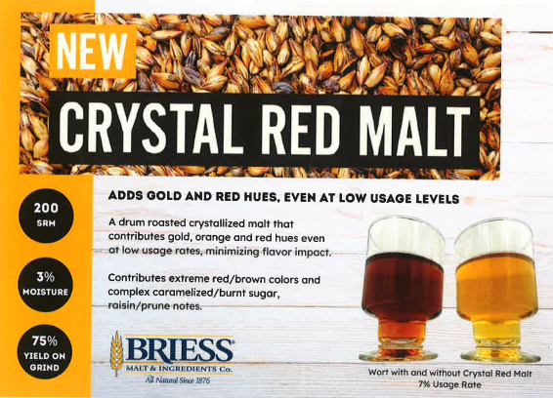
Red malt

Slide 13
Make malt tea
ASBC Hot Steep Malt Sensory Method
52g of malt in a grinder. Grind for 10 seconds.
Add malt to thermos with 400mL of water at 149*
Cap and shake for 20 seconds. Let sit for 15 minutes.
Filter, cool, taste.

Slide 14
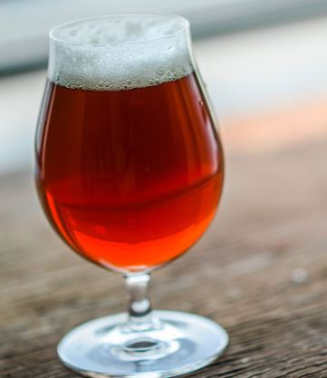
takeaways
Balance caramel malt, roast malt, hop bitterness.
Restrained esters; use lager yeast or ferment cool with an ale yeast.

Slide 15
Thank you

