Slide 1
Barleywine

Slide 2
Agenda
History
Style Comparison
Recipe Considerations
Process Considerations

Slide 3
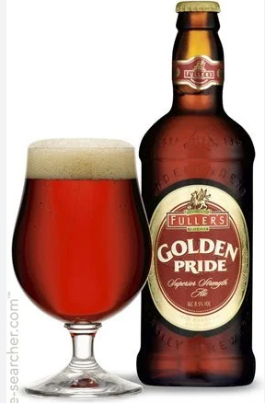
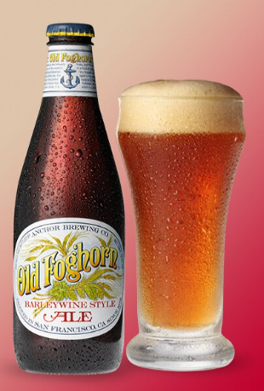
England Barleywine is currently the strongest English beer style. The ingredients mimic pale ale & bitters America the original American craft brewers’ seasonal beer. The ingredients mimic American Pale ale. 1975 – Anchor Brewing Old foghorn 1983 – sierra Nevada bigfoot

Slide 4
English American

Slide 5
English American

Slide 6
17D English Barleywine 22C American Barleywine

Slide 7
17D English Barleywine 22C American Barleywine

Slide 8
17D English Barleywine 22C American Barleywine

Slide 9
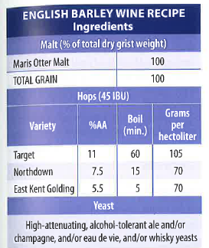
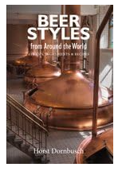
Sample Recipes - English
https://beerandbrewing.com/make-your-best-english-barleywine/
Craft Beer & Brewing Magazine
16 lb Maris Otter
1 lb C-45
1 lb Amber malt
East Kent Goldings
Any English yeast (1028 London Ale)

Slide 10
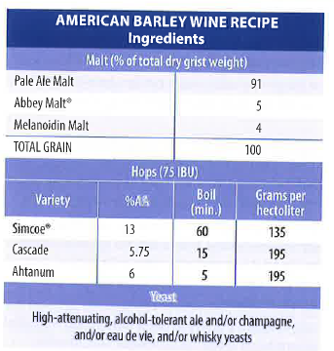
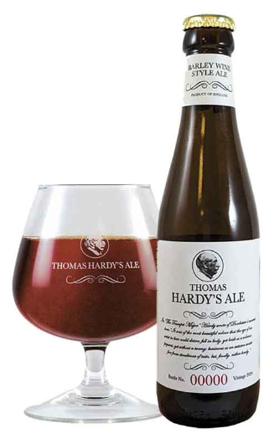
Sample Recipes - American
https://beerandbrewing.com/make-your-best-american-barleywine/
Craft Beer & Brewing Magazine
10 lb Maris Otter
10 lb Vienna
1 lb C-60
½ lb C-80
1 lb table sugar
Magnum + 2 other American hops
Lager yeast (2206 Bavarian Lager)

Slide 11
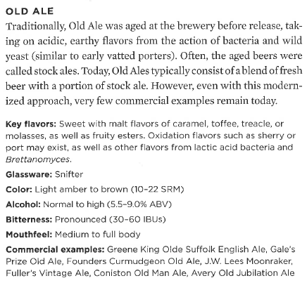
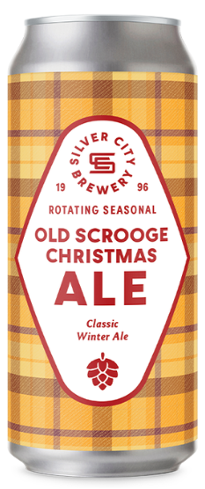
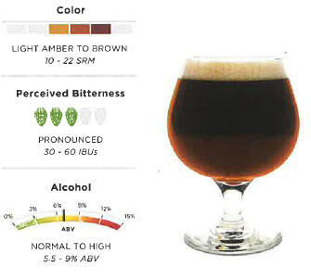
old ale
65% 2-Row
13% Munich
16% MOPA
2% C-40
2% C-75
26 IBUs

Slide 12
Process Considerations
High original gravity
English & American 1.080 – 1.120 / 19.3P – 29P
Thick mash is OK (.9L per lb); sparge slowly.
Your mash temp should not be too high; the beer should not finish too sweet.
Final gravity 1.016 – 1.030 / 4P – 7.5P
Either max out your mash tun, use an extended boil, sparge less, adjust the gravity with extract, or brew two batches into the same fermenter.
Use a big, healthy yeast pitch; buy extra yeast, make a starter, lots of aeration, etc…
Start at the low end of the fermentation temperature range, and ramp up to low 70s when the beer is about half-way attenuated.
Low carbonation (1.5 CO2 volumes).
Store to smooth.

Slide 13
Process Considerations
Mash Steps:
100* for 15 minutes (hydration rest)
112* for 15 minutes (improves mash filtration for more sugars into the wort)
149* for 45 minutes (beta amylase rest, produces shorter sugar chains / more fermentable)
161* for 5 minutes (alpha amylase rest, converts the remaining sugar into dextrines, produces longer sugar chains, to add body and a richer malt profile)
Mash out at 171* (denatures the remaining enzymes and stabilizes the sugar composition)

Slide 14
For Example…
15 lb Maris Otter
6 lb Munich
.5 lb C-40
.5 lb C-75
40 IBUs with whatever hop I have in the drawer (60 & 5 minute additions).
Use the recommended mash steps.
Boil for about 2 hours.
Aiming for about 22P OG, but we’ll see…
Aiming for about 3-4 TG, but we’ll see…
Wyeast 1728 (Scottish Ale) on a 24 hour starter.
Ferment around 68* for about 3-4 days, then around 72* for another 3-4 days.
I would like to try the beer fresh, as an English Barleywine, but also age it and try it again after a few months.
https://wyeastlab.com/product/scottish-ale/

Slide 15
THANK YOU
Resources
BJCP Style Guidelines https://dev.bjcp.org/style/2021/beer/
Craft Beer & Brewing Magazine
https://beerandbrewing.com/
“Beer Styles From Around the World,” by Horst Dornbusch
“Barleywine,” by Fal Allen & Dick Cantwell

